Slide 1

.NET Bootcamp

Slide 2
Overview
HTML Review
CSS Review
Responsive web design
Bootstrap
For Next Class

Slide 3
HTML Review
HyperText Markup Language
Building block for web pages
A markup language defined the structure and presentation of raw text
HTML5 is the current major version of HTML
Released in 2008
Mainstream adoption in 2014

Slide 4
HTML Review – Elements
Elements consist of an opening tag, the content, and a closing tag
Opening tags start with an angle bracket <, followed by the element name and any attributes of that element, and close with an angle bracket >
<p style=“color: red;”>Content</p>
Closing tags start with an angle bracket <, followed by a forward slash / and the element name (without any attributes), and close with an angle bracket >
<p style=“color: red;”>Content</p>
Special case for self closing tags where there is no need for content between the tags where the tag opens with an angle bracket <, followed by the element name and any attributes of the that element, and close with a forward slash / and an angle bracket >
<br />

Slide 5
HTML Review – Attributes
Attributes are values added to the opening tag of an element to configure or change the element
Attributes consist of the attribute name, followed by an equals sign =, and a value enclosed in quotes “”:
<p style=“color: red;”>content</p>

Slide 6
HTML Review – Unique ID Attribute
A special attribute called an ID attribute can be assigned to elements in order to uniquely identify between elements
Used by CSS or JS to manipulate the element
Valid id attribute values should begin with a letter and should only contain letters (a-z), digits (0-9), hyphens (-), underscores (_), and periods (.)
<p id=“CodeExample”>content</p>

Slide 7
HTML Review – Basic Elements
Document Type Declaration
Required as the first line of an HTML document and is an instruction to the browser about what type and version of document to expect
For HTML5, we use:
<!DOCTYPE html>
<html>
Root of an HTML document
Should be added right after the document type declaration
All content should be contained between the opening and closing <html> tags
<html> … </html>

Slide 8
HTML Review – Basic Elements
<head>
Contains general information about the page that isn’t display on the page itself
Often includes metadata and links to external files such as CSS
<html> <head> … </head> … </html>

Slide 9
HTML Review – Basic Elements
<body>
Contains the content of the HTML document and is rendered by the browser
Only 1 <body> element is allowed in a document
<html> … <body> … </body> … </html>

Slide 10
HTML Review – Basic Elements
<title>
Title element contains text that defines the title of the HTML document
Can only be contained inside the document’s <head> element
<!-- comment -->
Comment element contains comments that will not be rendered by the browser
Can span multiple lines

Slide 11
HTML Review – Basic Elements
<h1>
Highest level of a heading element
<h2>
<h3>
<h4>
<h5>
<h6>
Smallest level of a heading element

Slide 12
HTML Review – Basic Elements
<p>
Paragraph element that contains and displays a block of test
<span>
Span element that is an inline container for text and can be used to group text for styling proposes
<em>
Emphasis element that is usually used to italicize text
<strong>
Strong element that is usually used to bold text
<br>
Line break element that is used to insert a line break in text
Note: the break tag requires to only have an opening tag, no closing tag

Slide 13
HTML Review – Basic Elements
<div>
Division element used as a container that divides an HTML document into sections
<ul>
Unordered List element used to create a list of items in no particular order usually rendered with a bullet point by default
<ol>
Ordered List element used to create a list of items in a sequential order usually numbered by default
<li>
List Item element used to list items inside the Unordered Lists or Ordered Lists

Slide 14
HTML Review – Basic Elements
<img src=“”>
Image element used embed images in the document
The src attribute is mandatory and contains the URL to the image
Self closing tag, so no closing tag is needed
<a href=“”>
Anchor element used to create a hyperlink to another HTML document
Attribute href determines the location the anchor element points to
A special tag (#) in the href attribute can create a hyperlink to any part of the same HTML document

Slide 15
HTML Review – Table Elements
<table>
Table element used to represent two-dimensional tables consisting of rows and columns
<tr>
Table Row element used to add rows to a table
<td>
Table Data element used to add cells (columns) to a row of data in a table
Special colspan or rowspan attribute can be used to span data across multiple columns or rows

Slide 16
HTML Review – Table Elements
<thead>
Table Head element used define the heading of table columns inside table rows
<tbody>
Table Body element used define the body of the table containing all the table data
<tfoot>
Table Foot element used to add footer content to the table
<th>
Table Heading element used to style a specific cell as a header cell

Slide 17
HTML Review – Form Elements
<form method=“post” action=“/submit”>
Form element used collect and send data
method attribute tells which HTTP verb is to be performed
action attribute tells where to send the information
<label for=“username”>
Label element used to describe input
for attribute links the input id attribute to the label element

Slide 18
HTML Review – Form Elements
<input type=“”>
Input element used to input data on a document
Name attribute used specify name of key to be used in key/value pair when data is sent in form
type attribute can consist of one of many values:
text – single row of text input
password – single row of censored text input
number – single row of only numbers and number-related characters
range – a range slider to select from minimum to maximum values by an increment
checkbox – single checkbox item; can be grouped using same name attribute
radio – single radio button item; grouped by using same name attribute
submit – creates button to be used to submit the form and execute the action

Slide 19
HTML Review – Form Elements
<select>
Select element used to create a dropdown list
<option>
Option element used to specify options in select element
<textarea>
Text Area element used to render a multi-line textbox

Slide 20
HTML Review – Semantic HTML
Introduces meaning to the HTML code
Used to use <div> tags to as a general-purpose element to create headers/footers/etc
Semantic elements most used:
<header> - describes content at top of page
<nav> - describes content for navigation
<main> - describes main content
<footer> - describes content at bottom of page
<section> - describes content for grouping distinct sections of content together
<article> - describes content for containing related individual standalong pieces of content

Slide 21
CSS Review
Cascading Style Sheets
Used to style how HTML elements appear
Define styles and change the layout and design of a document

Slide 22
CSS Review – Styling
CSS can be used inline by adding the style attribute to any HTML element
CSS can be written in separate file(s) ending in .css
Best practice to separate CSS from HTML and not use inline HTML attribute since it allows for easier maintainability and reuse

Slide 23
CSS Review – Selectors
Define the set of elements to which the CSS rule applies

Slide 24
CSS Review – Selectors
Type selectors are used to match all element of a given html element tag name regardless of nesting
<h1>content</h1> <p>content</p> p { color: green; }

Slide 25
CSS Review – Selectors
Class selectors are used to match all elements of any HTML element tag using the same class attribute
<h1 class=“green_color”>content</h1> <p class=“green_color”>content</p> <p>content</p> .green_color { color: green; }
Use the dot (.) notation to describe class selectors in CSS
HTML elements can have multiple class attribute values
<p class=“green_color large_text other_stuff”>content</p>

Slide 26
CSS Review – Selectors
ID selectors are used to match the element of any HTML element tag using the same id attribute
<h1 id=“heading1”>content</h1> #heading1 { color: green; }
Use the hash sign (#) notation to describe ID selectors in CSS
ID attributes should be unique across the entire HTML document

Slide 27
CSS Review – Selectors
Selectors can have specificity to determine which selectors are used in case of multiple conflicting values
<h1 id=“heading1”>content</h1> h1#heading1 { color: green; } h1 { color: red; }

Slide 28
CSS Review – Selectors
Chaining selectors can be used to set rules to elements that match all criteria
<div class=“header”> <h1 class=“main_heading”>content</h1> .header { color: green; } .header.main_heading { color: red; }

Slide 29
CSS Review – Selectors
Descendant selectors are used to match element that are descended from another matched selector
<div class=“header”> <h1 class=“main_heading”>content</h1> </div> div h1 { color: green; }

Slide 30
CSS Review – Selectors
Grouping selectors can be used to set rules that match multiple elements
<h1 class=“main_heading”>content</h1> <p class=“main_text”>content</p> .main_heading, .main_text { color: red; }

Slide 31
CSS Review – Declaration
Declarations are key-value pairs of a CSS property and its value
Key is separated from value by a colon
Values can contain multiple values
Declarations must be ended with a semi-colon
<p class=“main_text”>content</p> .main_text { color: red; }

Slide 32
Responsive Web Design
Responsive web design is a design approach allows for the rendering of content and styling to respond to the user’s screen size, platform, and orientation
Responsive web design uses grids and layouts to allow for content to flow
A best practice is be “mobile-first” in design, in other words, design for the mobile first, then design for larger devices such as desktops

Slide 33
Bootstrap
Uses a grid system that splits containers into rows
Each row can contain up to 12 columns
2 types of containers:
container is a fixed-width container
container-fluid is a full-width container

Slide 34
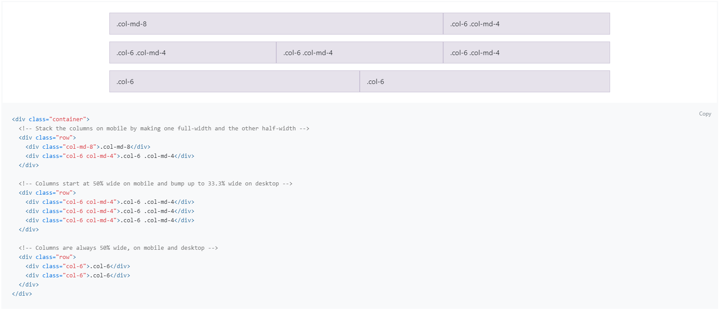
Bootstrap

Slide 35
Using Bootstrap
Download it and add it as a part of your project
Use a CDN link
https://getbootstrap.com/docs/4.5/getting-started/introduction/

Slide 36
For Next Class
Submit the project proposal document
Start creating wireframe screens and breaking down tasks of the project
Look over

